Slide 2
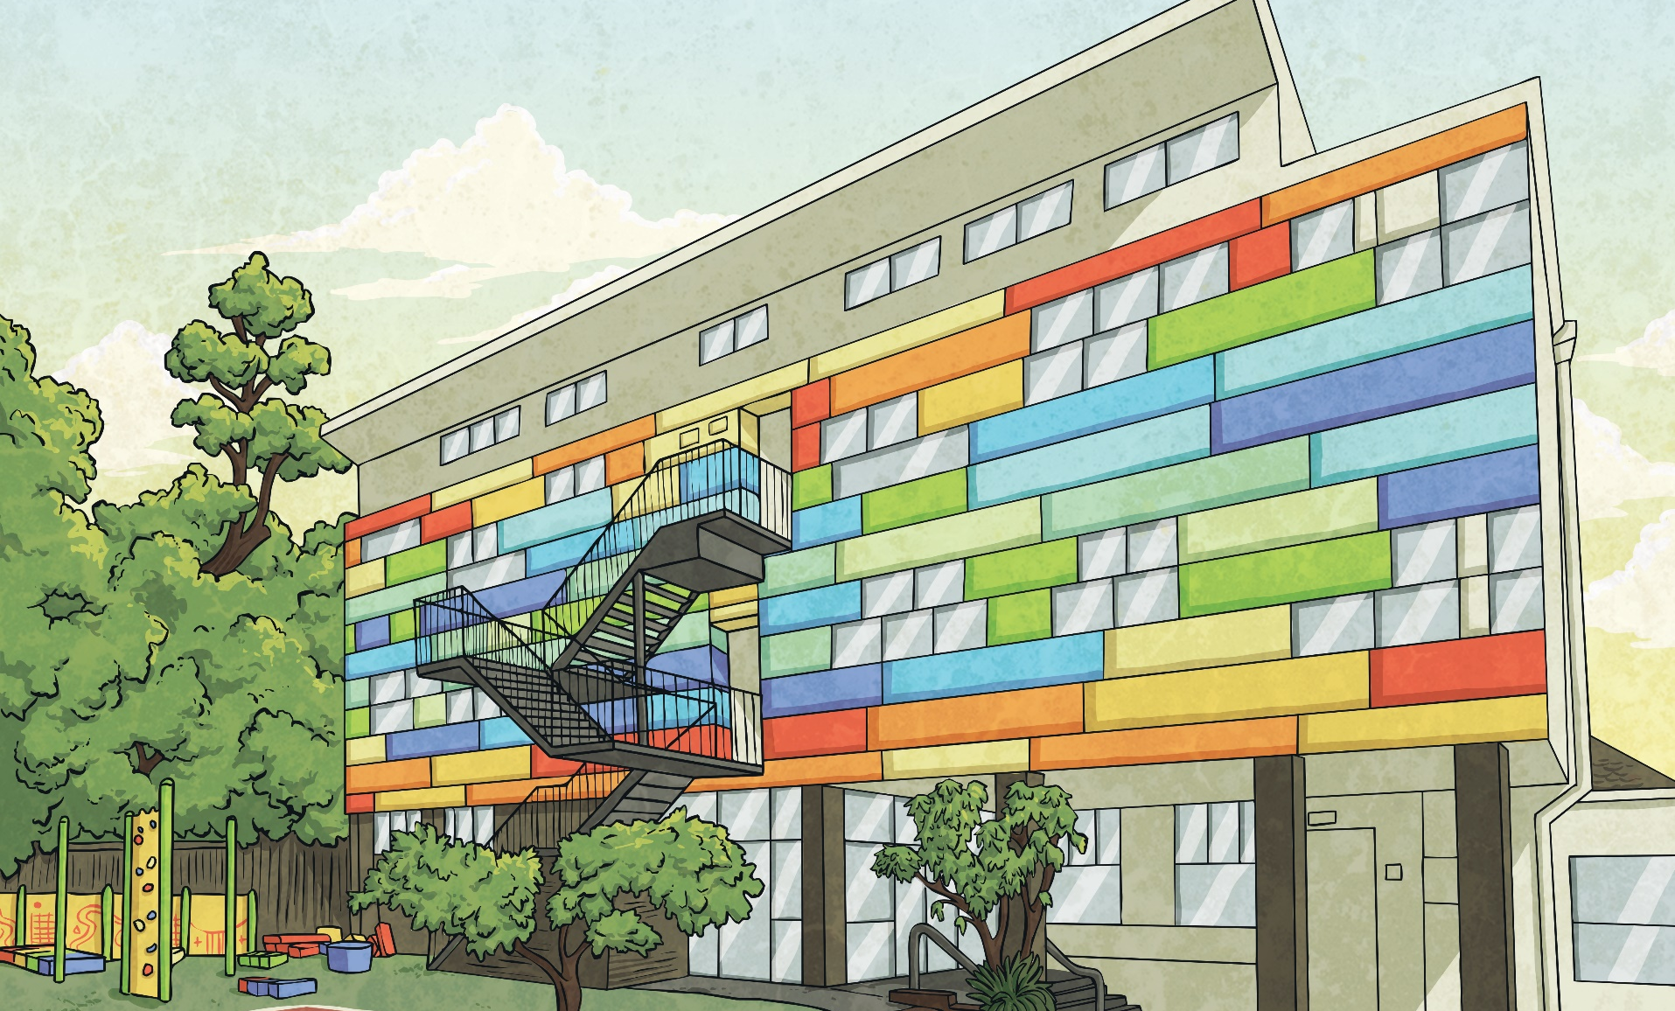
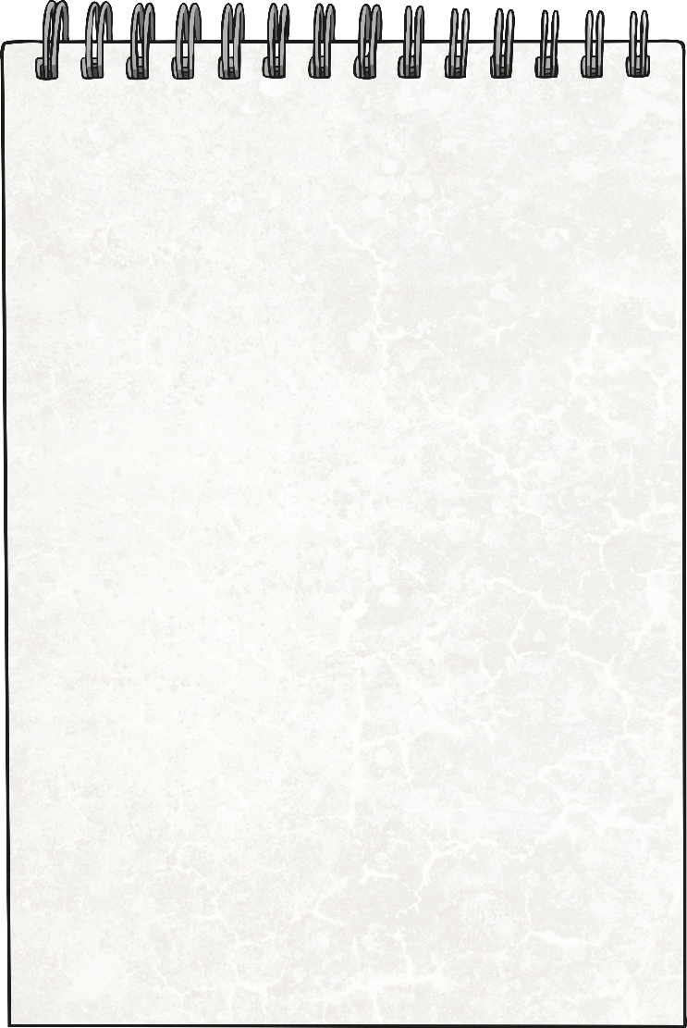
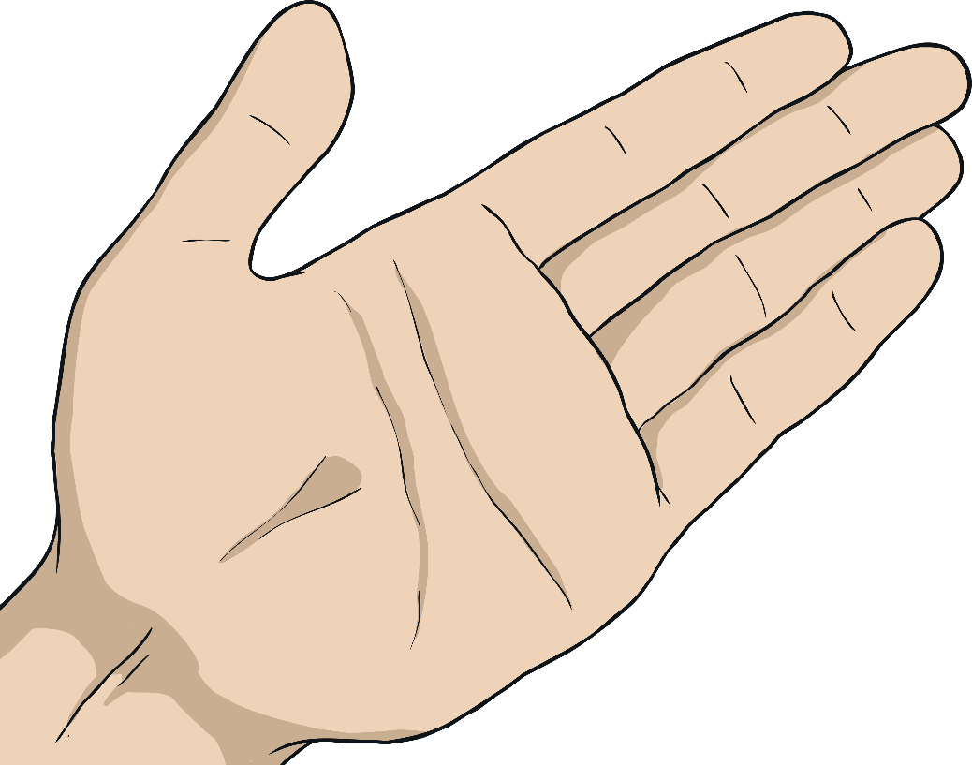
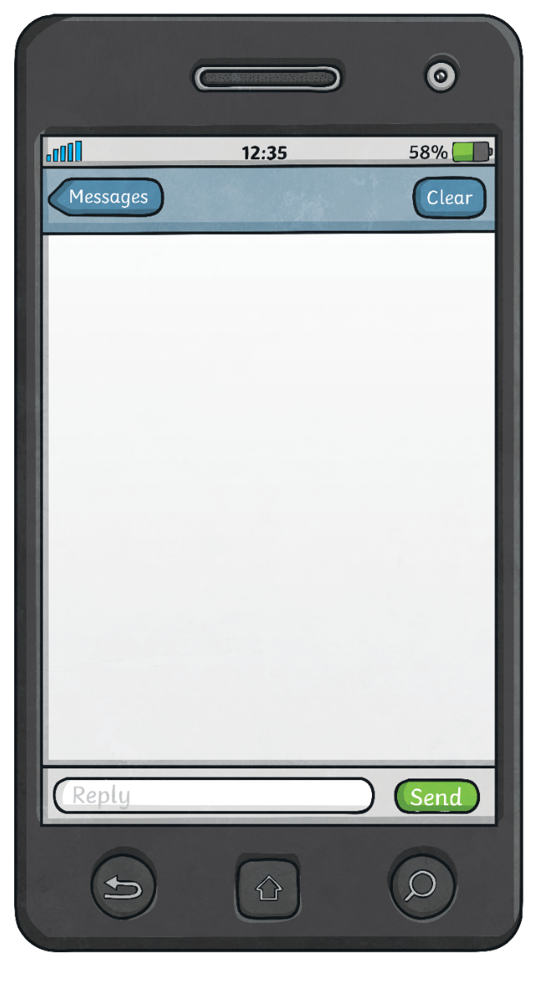

Improper Fraction to Mixed Number
Here we have a fraction greater than 1 represented with place value counters.
1
1
1
1
1
5
5
5
5
5
1
1
1
5
5
5
Remember mixed numbers and improper fractions are two different ways of describing the same fraction greater than 1.
Let’s write this fraction as both an improper fraction and a mixed number.
What methods could you use to convert
an improper fraction to a mixed number?
Improper Fraction
Mixed Number
8
=
1
3
5
5

Slide 3

Improper Fraction to Mixed Number
Let’s look at the method we can use to convert an improper fraction to a mixed number.
There are 8 equal parts.
We can use division to find out the number of wholes and remainder parts.
8
3
=
1
8 ÷ 5 = 1 r 3
5
5
1
1
1
1
1
5
5
5
5
5
Each whole has 5 equal parts.
1
1
1
5
5
5

Slide 4
Improper Fraction to Mixed Number
Let’s use division to convert a different improper fraction.
We can use division to find out the number of wholes and remainder parts.
There are 20 equal parts.
20
2
1
1
1
1
1
1
=
3
6
6
6
6
6
6
6
6
1
1
1
1
1
1
6
6
6
6
6
6
1
1
1
1
1
1
6
6
6
6
6
6
Each whole has 6 equal parts.
1
1
6
6
20 ÷ 6 = r
20 ÷ 6 = 3 r 2

Slide 5
Improper Fraction to Mixed Number
Let’s use division to convert a different improper fraction.
We can use division to find out the number of wholes and remainder parts.
There are 11 equal parts.
11
3
=
2
1
1
1
1
4
4
4
4
4
4
1
1
1
1
4
4
4
4
1
1
1
Each whole has 4 equal parts.
4
4
4
11 ÷ 4 = r
11 ÷ 4 = 2 r 3

Slide 6
Converting Improper Fractions
Have a go at changing these improper fractions into their mixed number equivalents. Show your working out.
10
1
11
1
23
3
=
3
=
5
=
4
3
3
2
2
5
5
1
1
1
1
1
1
1
1
1
1
3
3
3
2
2
5
5
5
5
5
1
1
1
1
1
1
1
1
1
1
2
2
5
5
5
5
5
3
3
3
1
1
1
1
1
1
1
2
2
5
5
5
5
5
1
1
1
1
1
3
3
3
2
2
1
1
1
1
1
1
1
5
5
5
5
5
1
2
2
1
1
1
3
1
5
5
5
2

