Slide 1

Reading Workshop
Wednesday 30th March

Slide 2
The importance of Reading
“Children who enjoy reading and think positivity about reading have on average much higher mental well being than those of their peers”
Golf and Clark Sept 2018
Reading introduces young people to new vocabulary, new ideas and experiences beyond their own, enabling them to better understand and absorb new information and concepts across the curriculum”
Sullivan and Brown 2013
Young people who enjoy reading very much are nearly five times as likely to read above the expected level for their age compared with young people who do not enjoy reading at all.
National Literacy Trust 2021

Slide 3


Slide 4
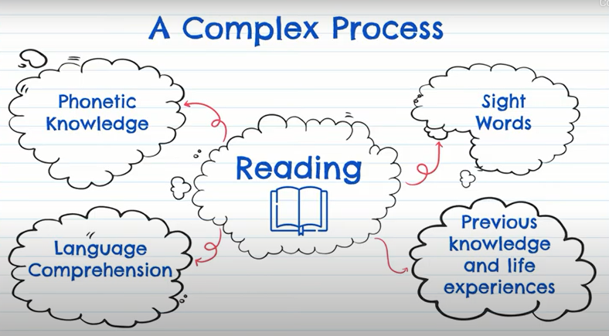

Slide 5
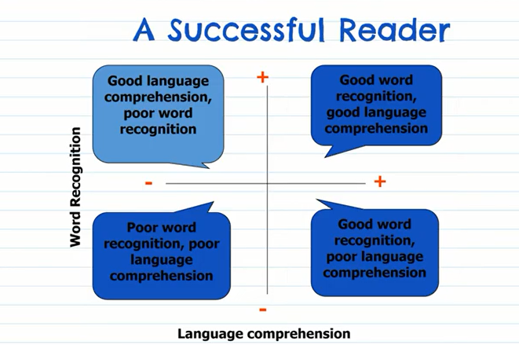
Taught, practised and developed daily

Slide 6
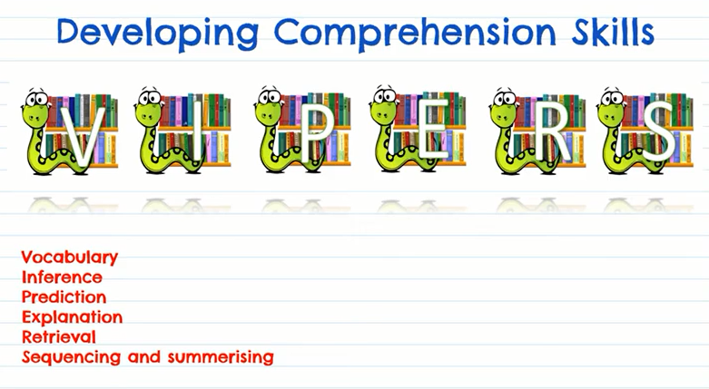

Slide 7

V – vocabulary (Understanding of words and meaning )
I – inference- (using their ideas based on what they have read and the clues in the text)
P – prediction (making predictions about the characters, plot and setting)
E – explain (explaining thinking and reasoning about key themes and events in the story)
R - retrieval – (finding answers to questions that are directly in the text)
S – sequencing / summarising – (key event in the story)

Slide 8
Helping your child at home
Listening to your child read
The books that are sent home should be the right level for your child and words should be readable (decodable) for your child. They are written to ensure steady progress and success.
Many books include helpful notes for parents inside the front cover and back covers to help you support your child when reading
Re-reading lets children see or hear words and phrases enough times to remember them, also also help them to think again about the ideas in the book, perhaps noticing things they missed the first time.

Slide 9
Reading to your child
Reading to your child will help them to enjoy reading and will build up vital comprehension skills. They can learn so much from how confidently and enthusiastically you model reading aloud and are to listen to the repetition and rhyme in your voice and be engaged in the story, without the pressures of decoding.

Slide 10
Reading to your child
Children benefit from listening to books that they can’t yet read themselves. Children will start to pick up the adventurous language and ideas that they might not have found in their independent reading or books at their reading level.

Slide 11
Making regular time for reading
Ten minutes of listening to your child read each day is one of the best ways you can support them become stronger readers.

Slide 12
Sound it out
We want children to enjoy the reading process but it can be disheartening when they come across unfamiliar words and sounds. It’s important to encourage them to try first. Remind them to use their phonics first and then blend.
If they are stuck, sound out and tell them the world quickly and move on, so they don’t lose confidence or motivation to try again.

Slide 13
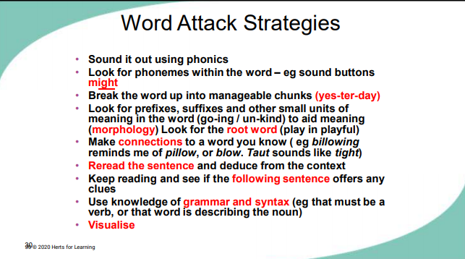

Slide 14
Talk about books, stories, words and pictures
Asking you child questions can help them to think about their reading. Try to ask open questions that begin with ‘how’ and ‘why’. If you can, try to get your child to go back to the text and pictures to tell you how they know the answer. Talking about what is happening in the picture, what the characters might be thinking, or what might happen next all help develop early reading skills.

Slide 15
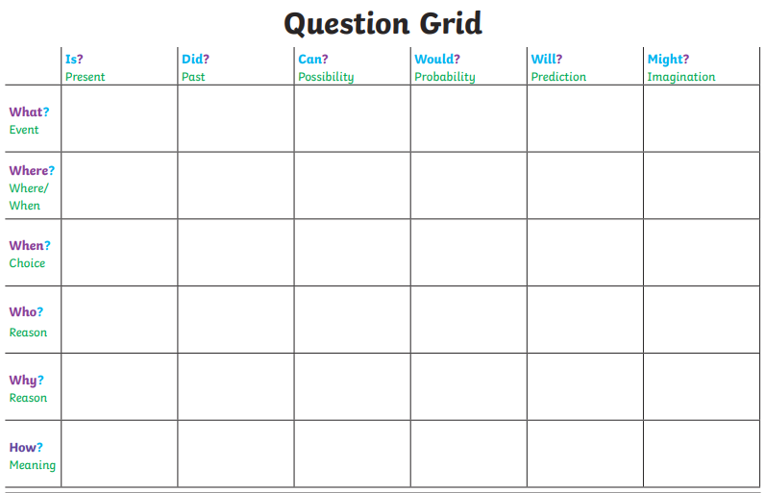

Slide 16
Echo reading

Slide 17
Building fluency – Echo Reading
Echo reading is a rereading strategy designed to help students develop expressive, fluent reading. In echo reading, the adult or confident reader reads a short segment of text, sometimes a sentence or short paragraph, and the student will echo it back.
“Students must hear fluent readers begin modelling if they are to understand how they should sound when they read fluently” (Miller and Veatch, 2011).
Since echo reading uses modelling as a form of assisted reading, students are able to gain the support and guidance they need to develop fluent reading skills.

Slide 18
What does it look like?
Adult/confident reader models fluent reading of a short segment, usually one sentence.
Student repeats or ‘echo reads’ the segment they have just read.
Adult/confident reader reads next sentence and has student echo… repeat until done.
The adult/confident reader must track the reading with their finger so that the student can follow.

Slide 19
What does fluent reading look like?
To help learners focus on their reading fluency, various aspects of reading aloud have been separated into six key elements. Each aspect works in partnership with the others to produce a rich and vibrant reading performance:
Pitch: The musicality of the reading voice – including tone and intonation.
Power: The strength given to the reading voice – including volume and stress.
Pace: The speed and rhythm at which we read.
Punctuation: The adherence to and understanding of the marks an author has placed upon the page.
Pause: The knowing of when not to read and for how long.
Passion: The emotion of the reading – including empathy and sympathy and the development of a reader’s love for the written word.

Slide 20
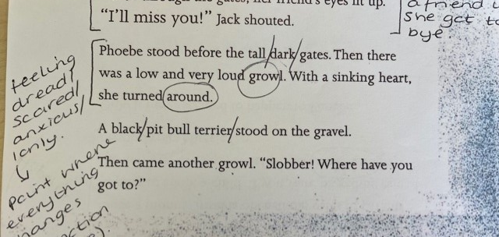
Text Marking

Slide 21
PRAISE
AND
ENCOURAGEMENT!!!

