Slide 1


reception
Information for
Parents

Slide 2
OUR VISION AND VALUES
School Mission Statement
As a school we follow the teachings of Jesus, this is accurately reflected through our school mission statement:
At St. Joseph’s we live, love and learn by the example of Jesus
School Vision
We pride ourselves on working together as a community and celebrating our experiences and aspirations. We are an ambitious, caring and aspiring learning community which is also accurately reflected through our school vision:
Aspiring for excellence for all, together as a Catholic community’.
School Values
Faith * Self Control *Resilience *Respect * Aspiration * Self Belief *Perseverance * and Friendship.

Slide 3
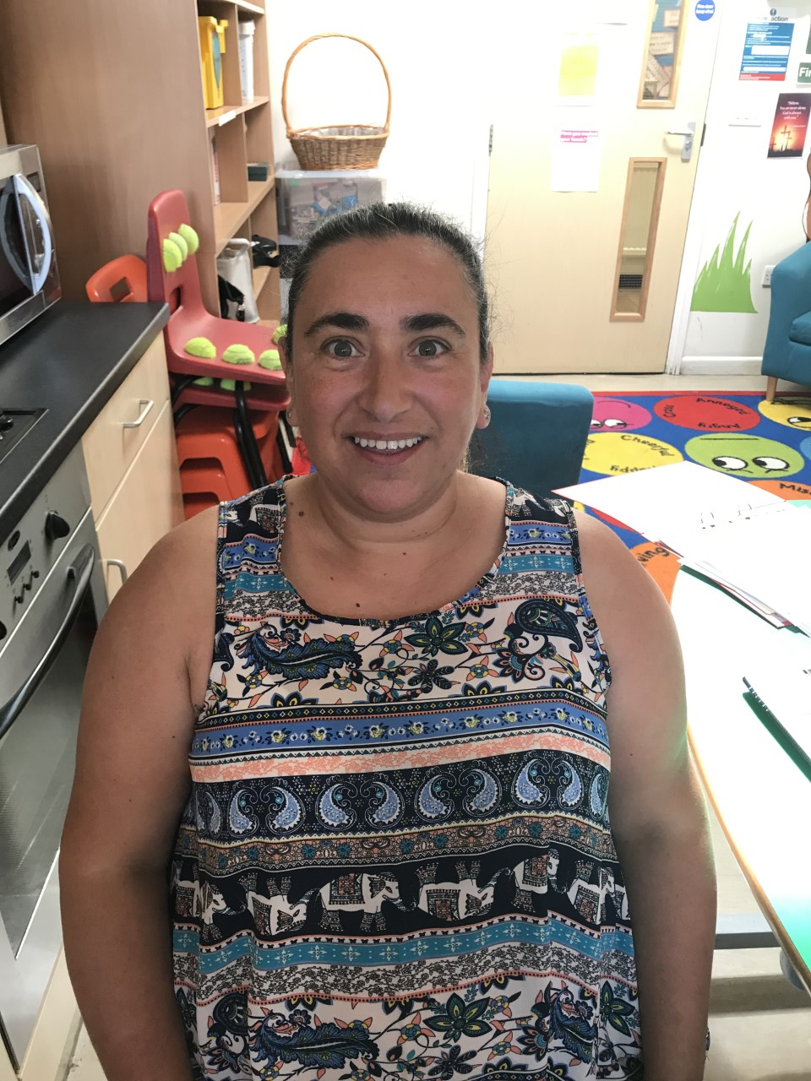
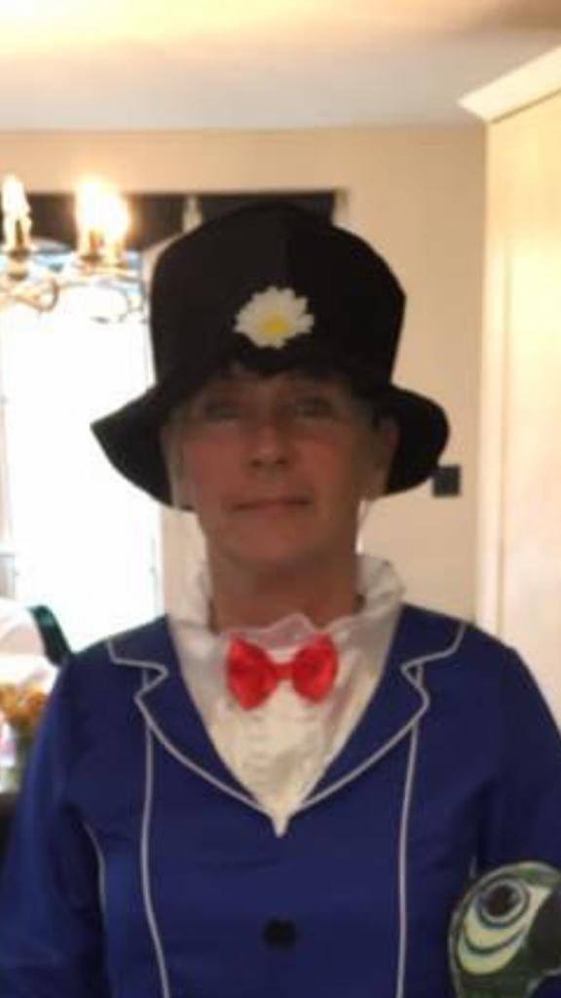
Early Years Foundation Stage
(EYFS)
                MEET THE TEAM

Slide 4
OUR Provision
Children have access to indoor/outdoor learning every day in all weathers:
- Wellies
- Coats
- Sunhats
Open Learning Area
    - Covered area
    - Classroom

Slide 5
Assessment
Baseline Assessment on entry
Christmas
Easter
End of year
Development Matters
Learning Journals

Slide 6
Month Bands
Emerging/Developing/Secure
Birth – 11 months
8 – 20 months
16 – 26 months
22 – 36 months
30 – 50 months Enter Nursery
40 – 60 months Enter Reception
Early Learning Goal (ELG) Leave Reception

Slide 7
Areas of Learning
PRIME AREAS | Communication and Language | Listening, Attention and Understanding Speaking
 | Physical Development | Gross Motor Skills Fine Motor Skills
 | Personal, Social, Emotional Development | Building Relationships Self-Regulation Managing Self
SPECIFIC AREAS | Literacy | Comprehension Word Reading Writing
 | Maths | Number Numerical Patterns
 | Understanding the World | Past and Present People, Culture and Communities The Natural World
 | Expressive Arts and Design | Creating with Materials Being Imaginative and Expressive

Slide 8
Characteristics of Learning
Playing and Exploring | Finding out and exploring Playing with what they know Being willing to ‘have a go’
Active Learning | Being involved and concentrating Keeping on trying Enjoying achieving what they set out to do
Creating and Thinking Critically | Having their own ideas Making links Choosing ways to do things

Slide 9
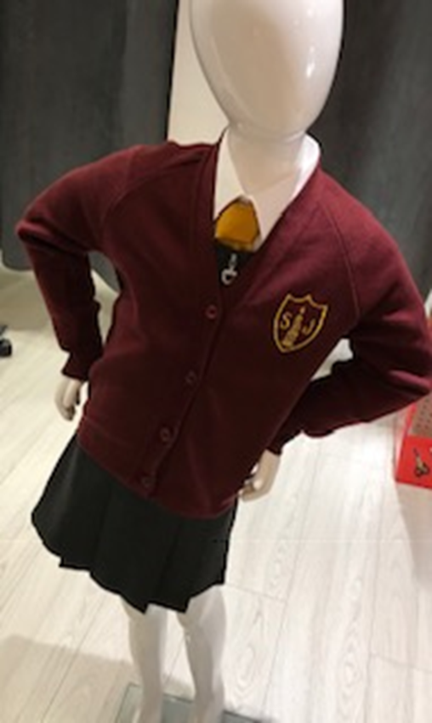
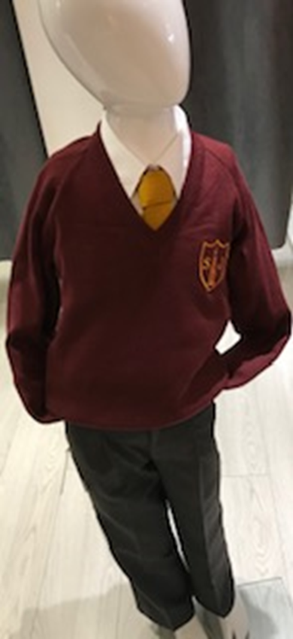
Uniform: Winter

Slide 10
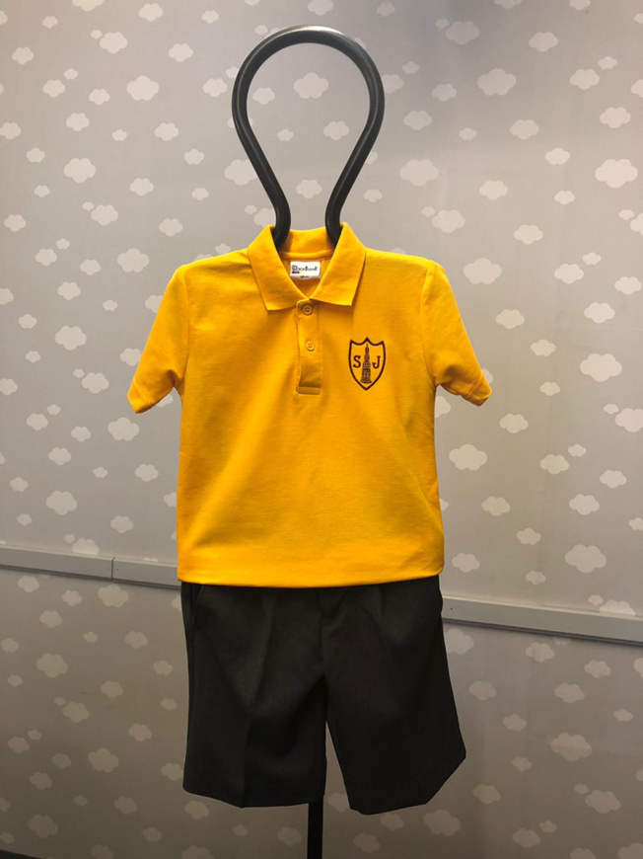
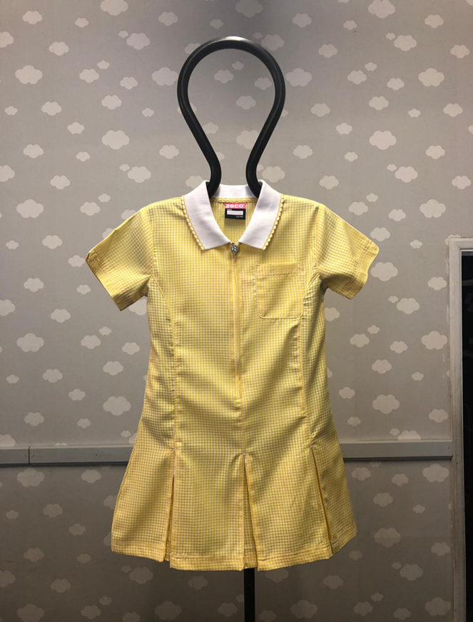
Uniform: Summer

Slide 11
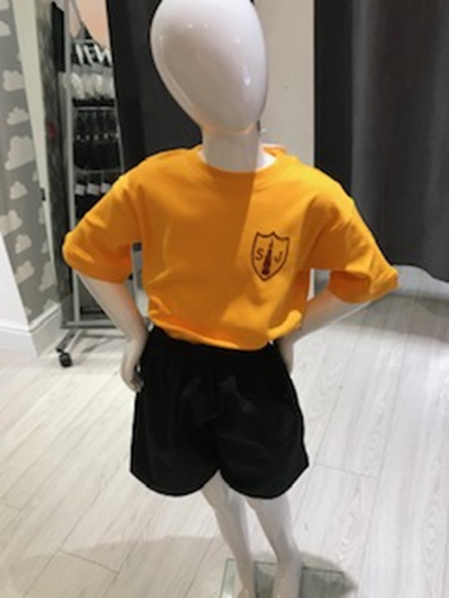
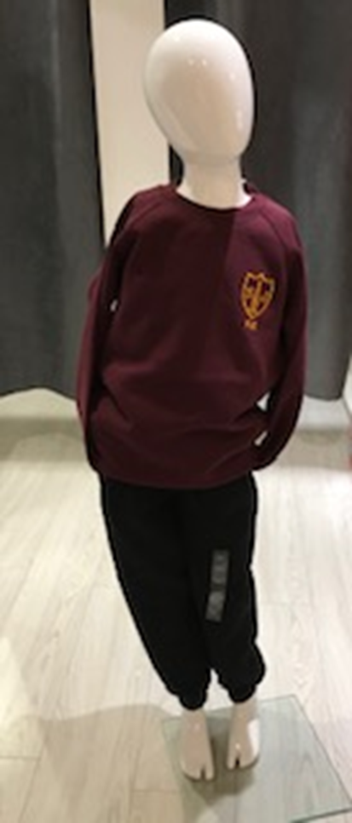
Uniform: PE Kit

Slide 12
Home Learning

Slide 13
Buddy System
Paired with a child in Year 6
Links throughout the Year: Buddy Assembly, paired reading, maths mornings
Children will be allocated a buddy in September.

Slide 14
Parent Partnership
Workshops
Local walks
Stay and Plays

Slide 15
Over the summer
Read stories
Talk lots
Gross/Fine motor skills
Board games – Ludo, Snakes & Ladders
Writing for a purpose – shopping lists, recipes, letters
Practice getting dressed…

