Slide 1

Nursery

Slide 2
OUR VISION AND VALUES
School Mission Statement
As a school we follow the teachings of Jesus, this is accurately reflected through our school mission statement:
At St. Joseph’s we live, love and learn by the example of Jesus
School Vision
We pride ourselves on working together as a community and celebrating our experiences and aspirations. We are an ambitious, caring and aspiring learning community which is also accurately reflected through our school vision:
Aspiring for excellence for all, together as a Catholic community’.
School Values
Faith * Self Control *Resilience *Respect * Aspiration * Self Belief *Perseverance * and Friendship.

Slide 3
OUR Provision
Children have access to indoor/outdoor learning every day in all weathers:
- Wellies
- Coats
- Sunhats
Open Learning Area
    - Covered area
    - Classroom

Slide 4
Assessment
Baseline assessment on entry
Christmas
Easter
End of year
Development Matters
Learning Journals

Slide 5
Month Bands
Emerging/Developing/Secure
Birth – 11 months
8 – 20 months
16 – 26 months
22 – 36 months
30 – 50 months Enter Nursery
40 – 60 months Enter Reception
Early Learning Goal (ELG) Leave Reception

Slide 6
Areas of Learning
PRIME AREAS | Communication and Language | Listening and Attention Understanding Speaking
 | Physical Development | Moving and Handling Health and Self-care
 | Personal, Social, Emotional Development | Making Relationships Self-confidence and Self-awareness Managing Feelings and Behaviour
SPECIFIC AREAS | Literacy | Reading Writing
 | Maths | Numbers Shape, Space and Measure
 | Understanding the World | People and Communities The World Technology
 | Expressive Arts and Design | Exploring and Using Media and Materials Being Imaginative

Slide 7
Characteristics of Learning
Playing and Exploring | Finding out and exploring Playing with what they know Being willing to ‘have a go’
Active Learning | Being involved and concentrating Keeping on trying Enjoying achieving what they set out to do
Creating and Thinking Critically | Having their own ideas Making links Choosing ways to do things

Slide 8
Timetable
Monday | Tuesday | Wednesday | Thursday | Friday
Funky Fingers/Registration
Whole School Assembly | Reflection | Singing | KS Assembly | Reflection
Indoor/Outdoor Child Initiated Learning
Phonics/English
Indoor/Outdoor Child Initiated Learning
Maths
Indoor/Outdoor Child Initiated Learning
Story Time/Pack for Home/Review of the Day/Home

Slide 9
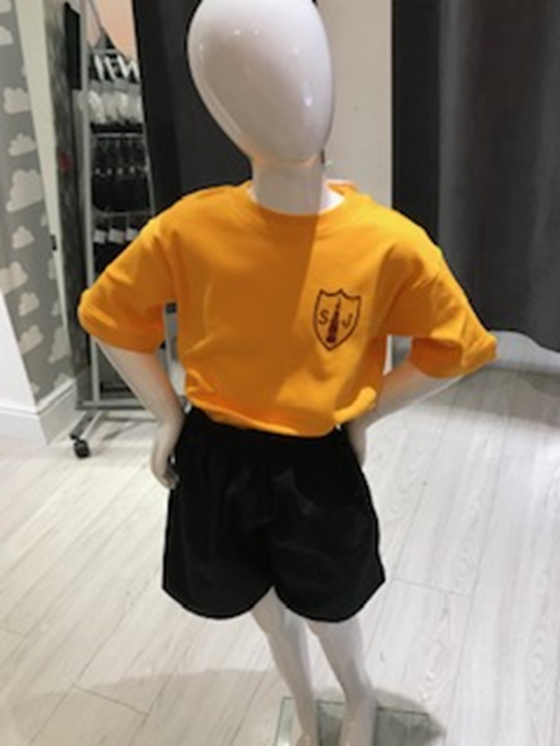
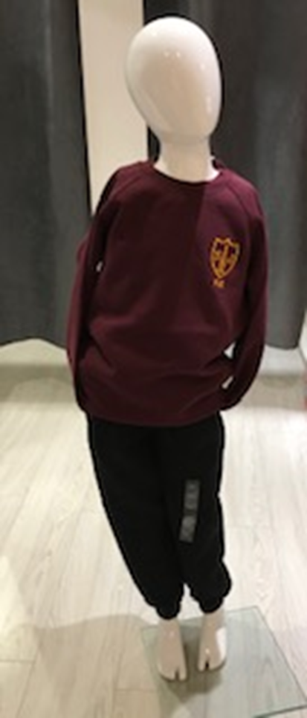
Uniform

Slide 10
Parent Partnership
Workshops
Local walks
Stay and Plays

Slide 11
Activities to support/engage inquisitive minds
Read stories
Talk lots
Gross/Fine motor skills
Board games – Ludo, Snakes & Ladders
Writing for a purpose – shopping lists, recipes, letters
Practice getting dressed…

Slide 12
Reading
‘If pupils are not able to read to an age appropriate level and fluency,they will be INCAPABLE of accessing the rest of the curriculum ,and they will rapidly fall behind their peers’.
Reading in EYFS & KS 1
Reading across school
Policy
Expectation /consistency
Will listen to readers

Slide 13
Behaviour and attitude
How leaders and staff create a safe,calm,orderly and positive environment and the IMPACT this has on behaviour and attitudes of pupils.
Calm and orderly school and class which enables learners to learn
Attendance and punctuality
Clear routines and excpectations acroos the school (ALL)
Clear policies – attendance & behaviour
Behaviour policy – clearly defined consequences and rewards (CONSISTENT)
Fairness of all teachers (CONSISTENCY)
Pupils motivated to achieve and attain.
The development of positive attitudes can have a longer term impact on how pupils approaches to learning tasks later on in education.
A positive and respectful school culture in which staff know and care about pupils.
A safe environment
Anti bullying focus
Peer on peer abuse
On line safety awareness

Slide 14
Personal development
Preparing pupils for life
Ensuring resilience and respect
Developing responsible and respectable adults
Developing and deepening understanding of British Values
Promoting equality of opportunity so that ALL pupils can thrive together ,understanding their differences in a positive not negative way and individual characteristics make us unique
Inclusive environment (regardless of age,race,gender,religion or sexual orientation)
Developing pupils character ,confidence,
Keeping them mentally healthy
Enabling awareness of online risks, gangs,sexual exploitation,radicalisation,substance misuse
Awareness of how to keep physically healthy
SRE
Aspirations and careers opportunity
Supporting next phases readiness

Slide 15
SMSC as part of Personal Development
Spiritual, moral,social and cultural education
Reflect on own beliefs and perspective on life
Knowledge of and respect of other faiths and cultures
Learning about themselves
Use of imagination and creativity in their learning
Willingness to reflect on experiences
Difference between right and wrong
Consequences of behaviour and actions
Interest in responding to ethical and moral views
Social skills
Community engagement
British values
Cultural influences and impact / awareness of

Slide 16
Personal development
Faith – Catholic school – Gospel values
PSHE – jigsaw
Reflections
Assemblies
Growth mindset
British values
SRE
Check in
Wellbeing
Wellbeing ROC
Discussions
Opportunities in curriculum to dev
Computing
Online safety unit (when)
½ termly online safety review
Reminder in every computing lesson

