Slide 1

Mental Health Support Teams in Schools
Hertfordshire & West Essex
Coping with exams stress:
A workshop for parents
By Education Mental Health Practitioner
Lia Prado

Slide 2
Objectives
What is SATs?
To understand what exam stress is
To know how to help children/young people cope with exam stress
Does anyone have any hopes for our session today?

Slide 3
Remember ….
”Some of the topics discussed may feel sensitive. Please remember to look after yourself and step out if you need to.”

Slide 4
What are SATs?
A part of your child’s journey
It is an assessment taken in Year 6
Reading
Maths
Grammar
Punctuation
Spelling
Remember: every child progresses differently

Slide 5
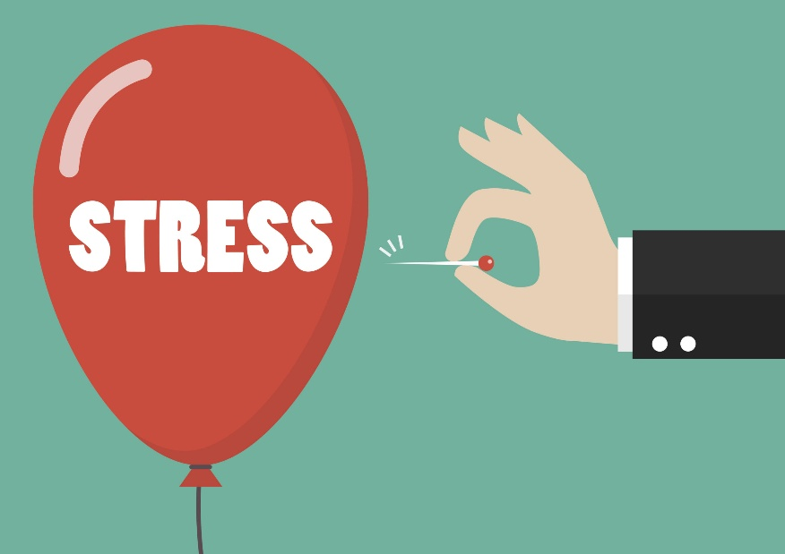
Let's talk about stress
Can you remember a time when you felt stressed?
Can you remember ever feeling stressed before taking a test or exam?

Slide 6


Slide 7
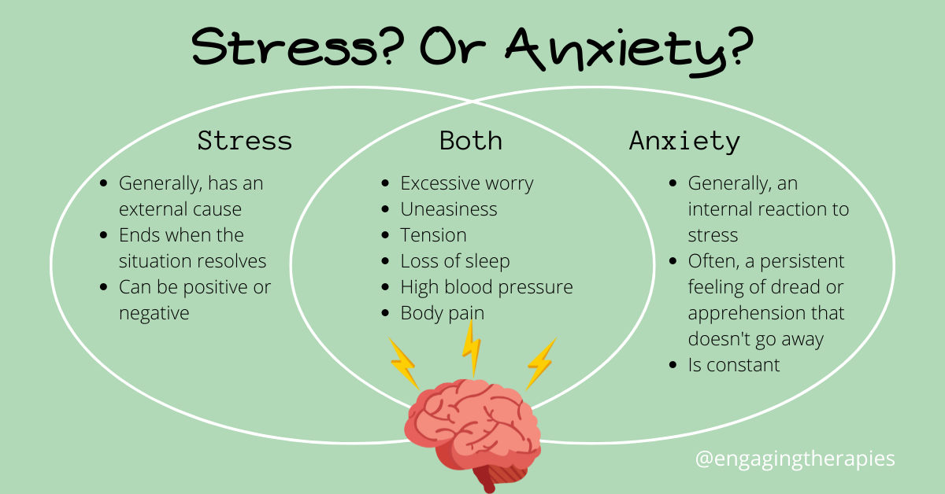

Understanding anxiety
”Too munch worrying can make us feel anxious”
Anxiety is the body’s way to trying to keep us safe. It prepares us to deal with challenges, such as tests, new situation, changes and so on.
Stress or Anxiety – how are they different?
Notes:
https://www.youtube.com/watch?v=FfSbWc3O_5M

Slide 8
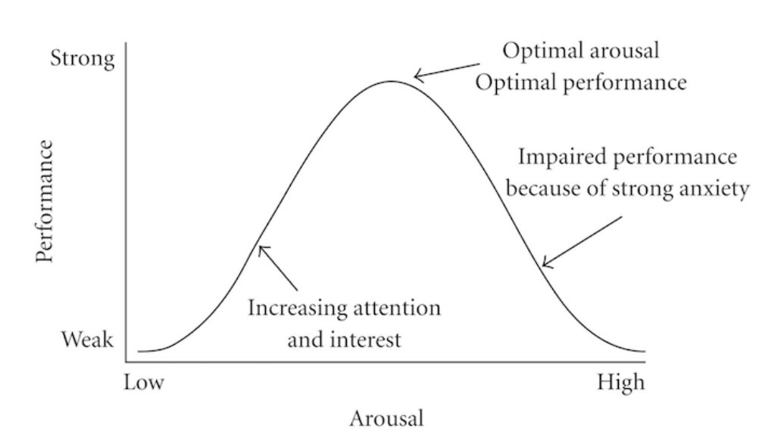
A little stress can be helpful
Stress can:
Leap you into action, when necessary, especially when there is a threat/danger.
Boots your performance
Strengthen resilience
Push you outside of your comfort zone resulting in personal growth.
Yerkes-Dodson law (1908)

Slide 9
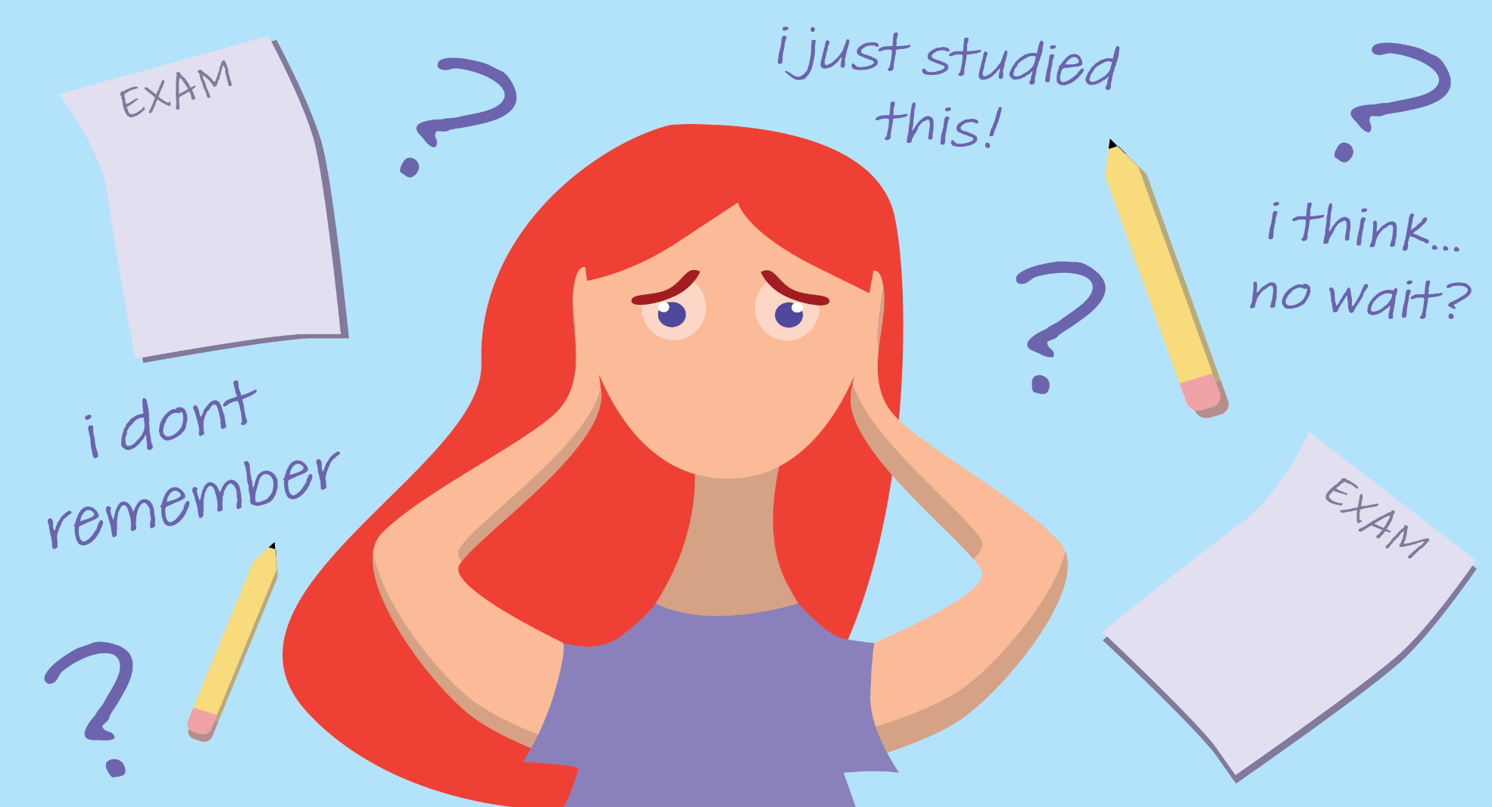
It’s normal to feel stressed before an exam!
Exam stress can be seen as spectrum. Some people only feel a little stress, while others totally debilitated and sick with anxiety!
The challenge is finding out how to manage the stress, so that works for your rather than against you!
96% of young people experience exam anxiety – it’s totally normal!

Slide 10
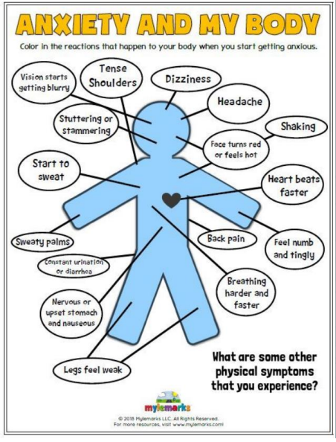

Physical symptoms of anxiety
Recognising how the body physically feels when we are feeling stressed and anxious can be a really helpful way to begin learning about our own experience of anxiety.
These physical responses are completely normal and natural, and part of the ‘fight or flight’ responses our body has to keep us safe from danger.

Slide 11
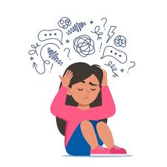
I have to get a good grade!
I feel like crying all the time. I am stressed with exams and my Mum is always shouting at me because she thinks I am not studying hard enough.
I feel like a million of things are going on in my head! I have to do so much revision for my STAs and I really want to get into my chosen college.
I’m not good enough
I don’t want to be a failure!
My siblings/parents/friends/got high grades so I need to get the same grades
Everyone is acing this exam except me!
What’s the point, I’m going to fail my exams anyway!

Slide 12
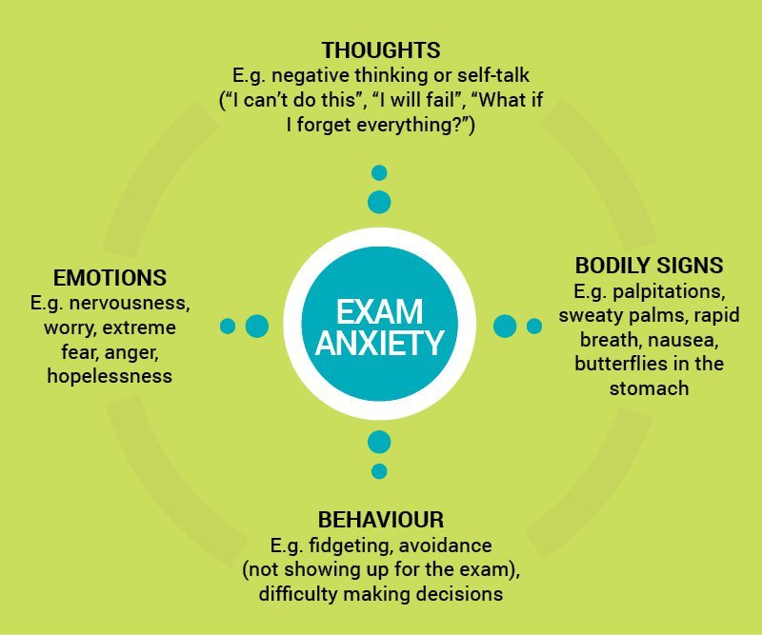
The cycle of exam anxiety
In CBT we consider out thoughts, emotions, behaviours and bodily sensations in a situation, and how they are related and influence each other.
Long term you’re only prolonging the anxiety!
In order to help cope with exam stress, we can look at how we could change our behaviour in order to influence our emotions, physical sensations and thoughts.
Short term relief

Slide 13
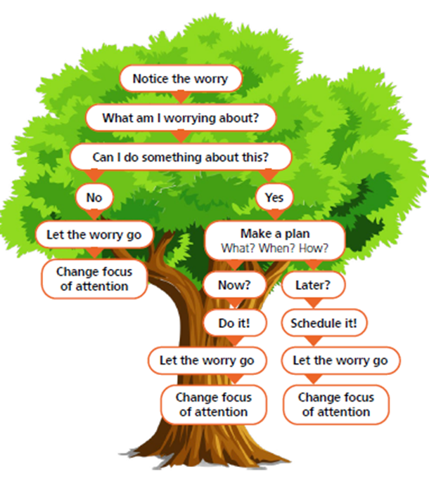
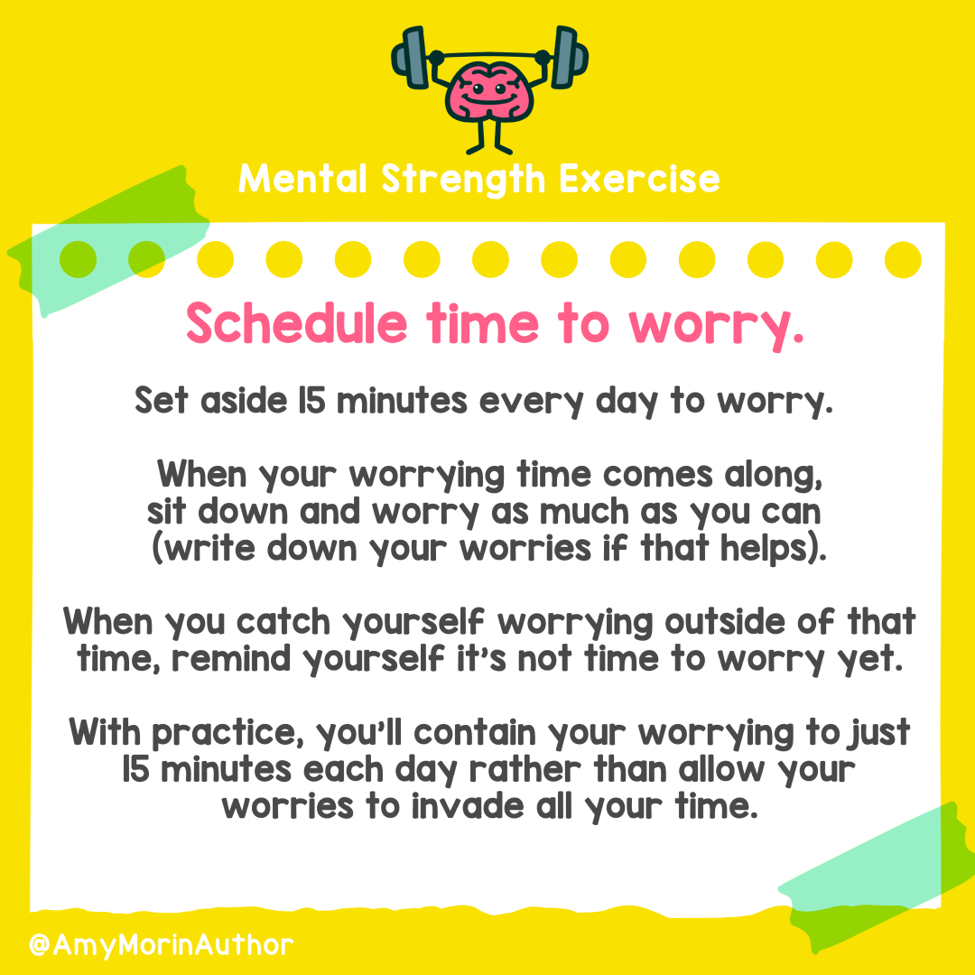
Strategies for managing worries
Worry Tree

Slide 14
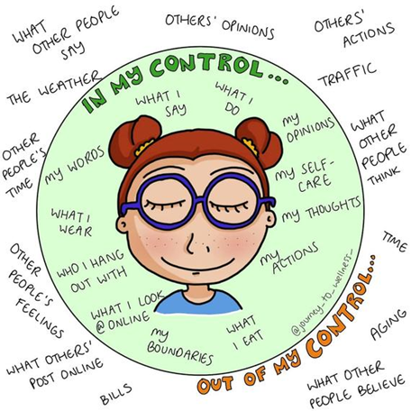
Circle of control
Think about what is in and outside your circle of control
Encourage them to:
Make a list of their current worries
Draw yourself in the middle
On the inside write all the things they can control
On the outside put all the things they can’t control
Focus and dedicate your time and energy on the things you can control

Slide 15
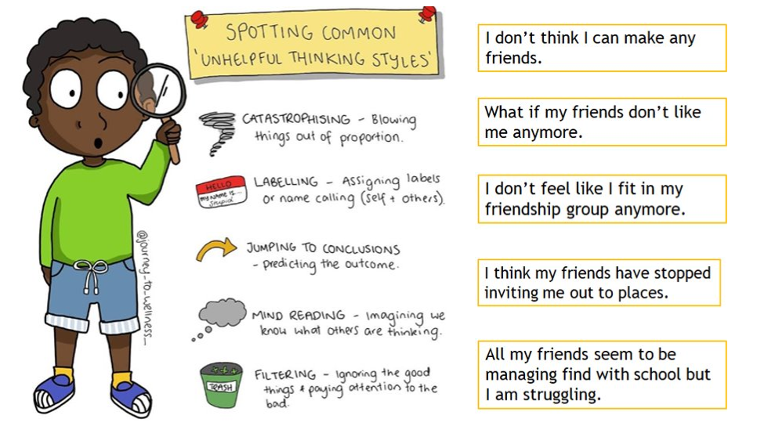

Unhelpful thinking styles

Slide 16
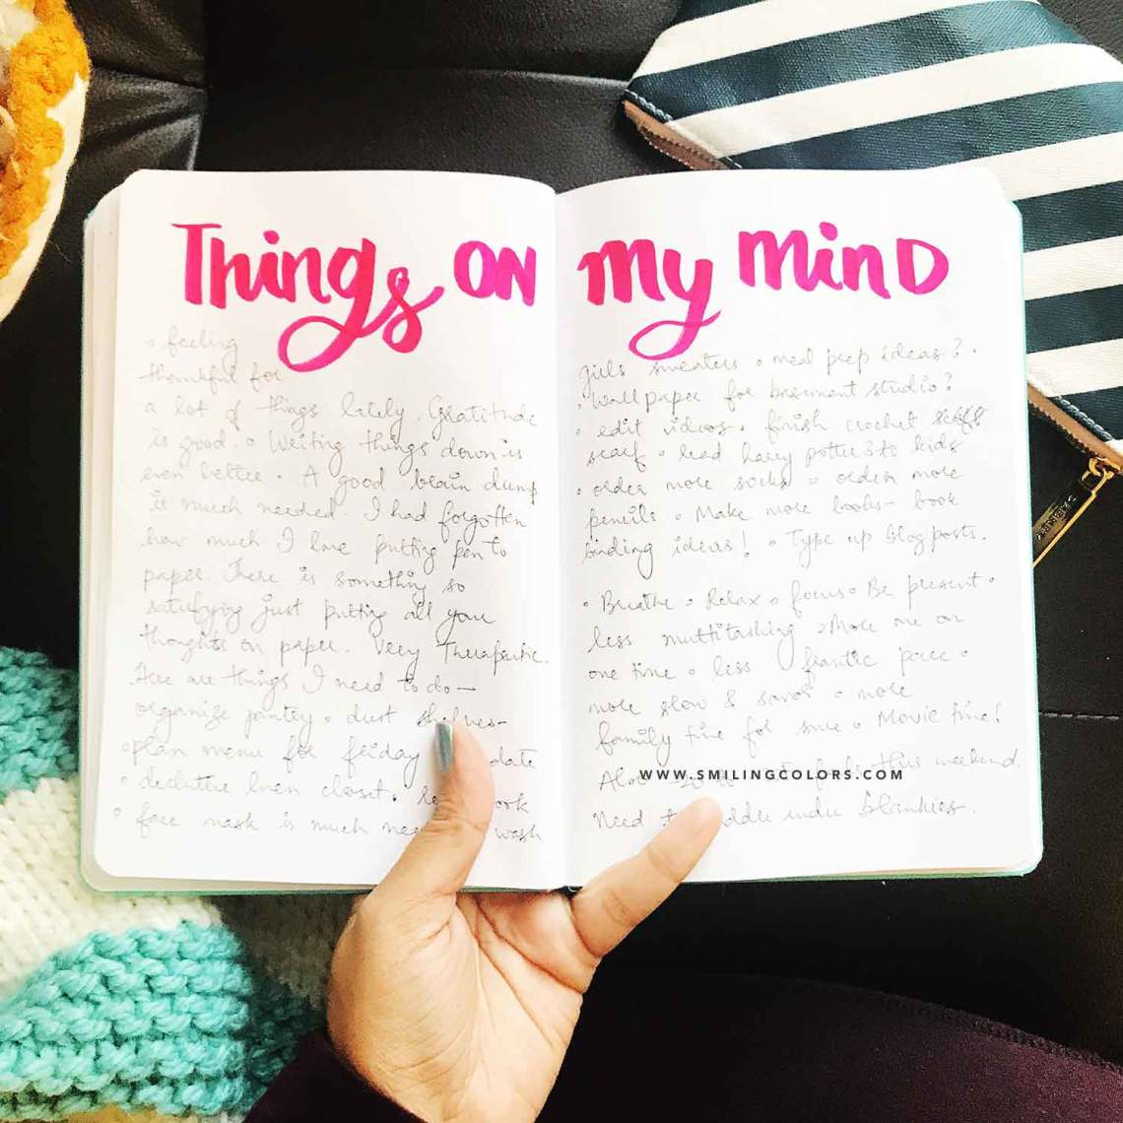
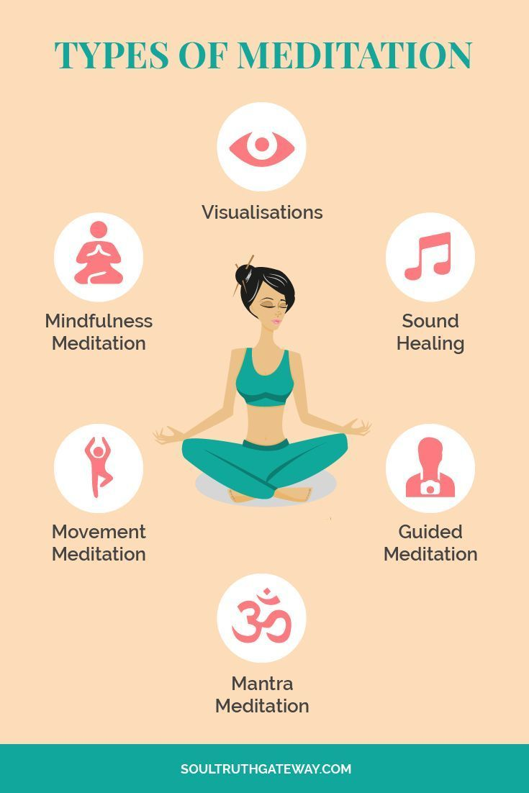
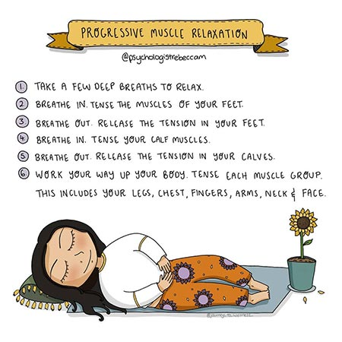

Relaxation and mindfulness

Slide 17
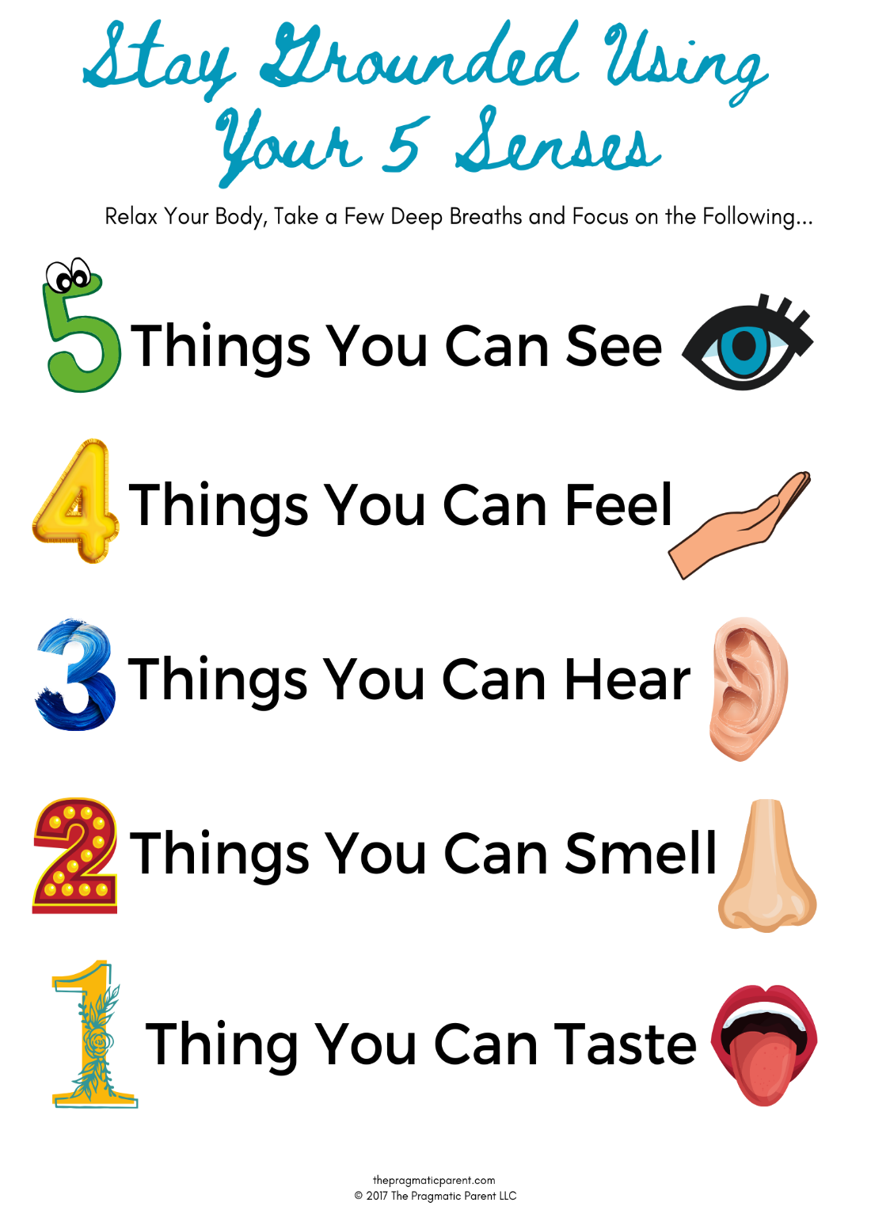
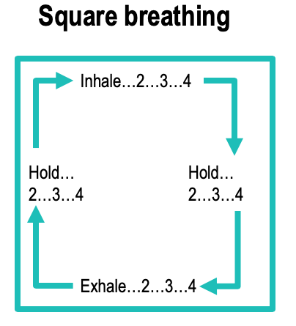
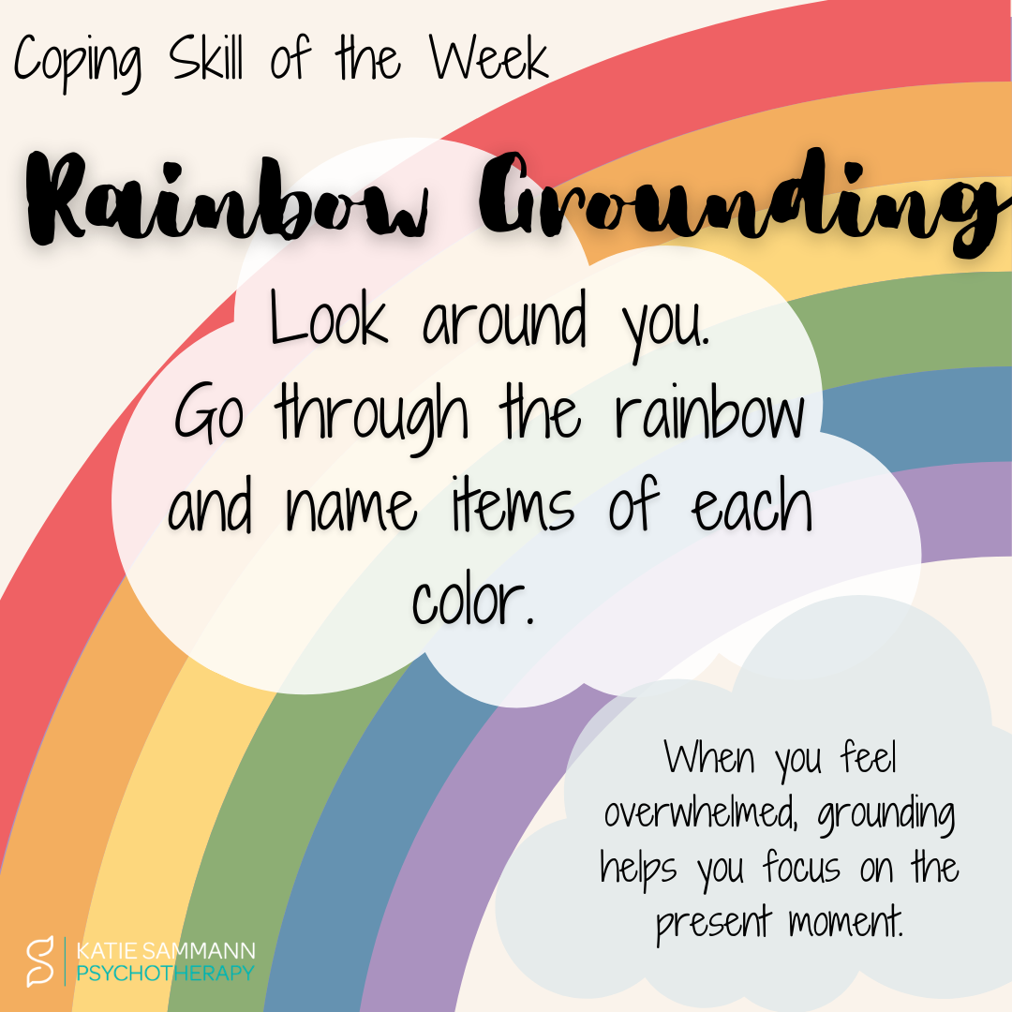
Examples of grounding techniques that can be used in and out of the exam hall

Slide 18




Self-soothing
Some ideas:
Watch TV / Netflix
Having a relaxing bubble bath
Listening to music
Spending time with friends
Shopping
Painting nails / face mask
Baking
Doing something practical (e.g. going for a walk)
Play football
Playing on PlayStation / Xbox

Slide 19

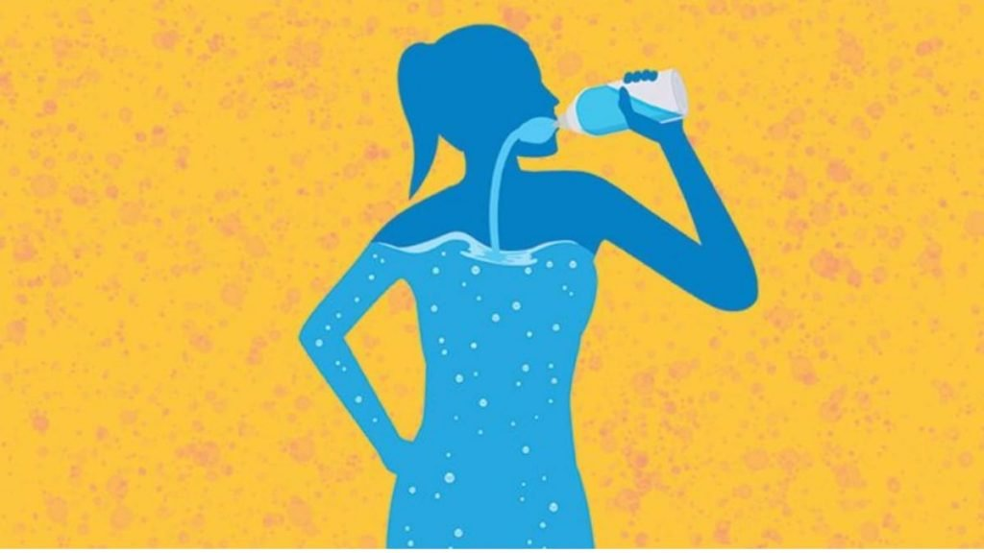
Physical Health: diet and hydration
Eat a balanced healthy diet
Where possible, involve your child in shopping for food and encourage them to choose some health snacks
Stay hydrated – drink lots of water throughout the day!

Slide 20

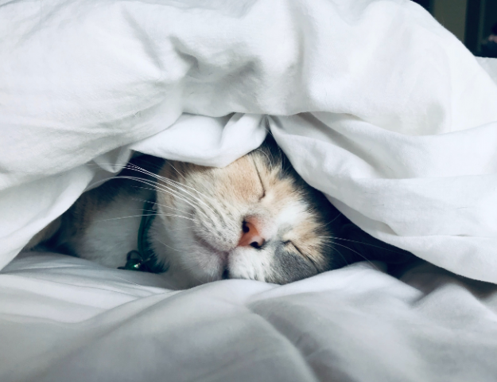
Physical Health: sleep
Most children/teenagers need 8 to 10 hours’ sleep a night.
Time to wind down before bed is important.
A good night’s sleep will benefit your child mote than late night information

Slide 21
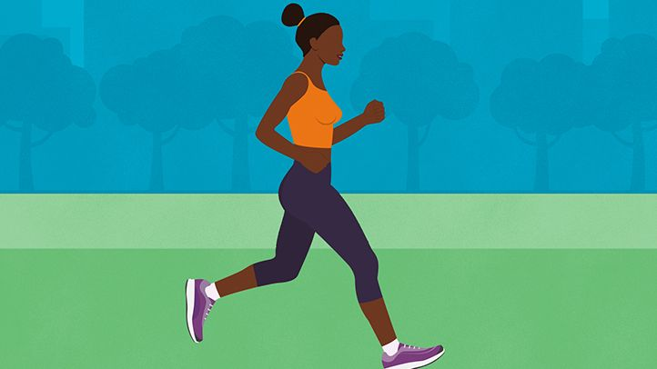
Physical Health: exercise
There are many benefits to exercise.
Exercise can help to clear the mind and relieve stress.
Encourage your child to exercise regularly throughout the week in a way that they find helpful.
Some people find that exercising with others can be particularly helpful for example taking part in a team sport or meeting with friends to go for a walk.

Slide 22
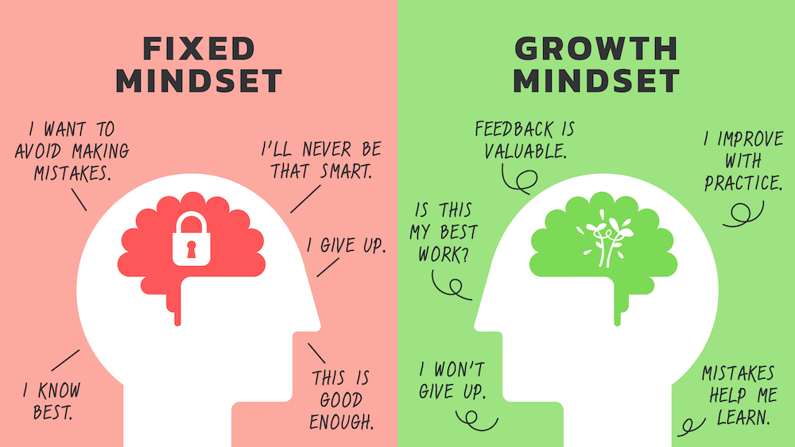
Be flexible
Try and be flexible around exam time
Staying calm yourself can help
Remember: exam don’t last forever

Slide 23

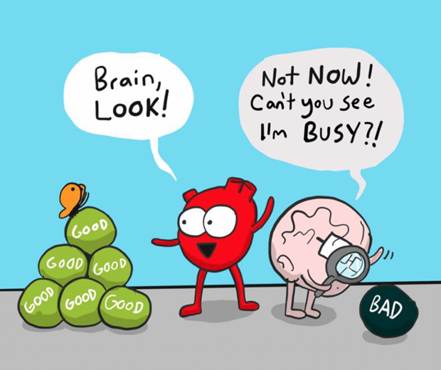
Do not add the pressure
Listen to your child
Give them support and avoid criticism
Before the test or exam, be reassuring and positive
Failing isn’t the end of the world!
Encourage your child to talk to you about the exam – talk about what went well and try not to dwell on the questions they found difficult.
Try to move onto thinking about the next test rather than dwelling on things that can ‘t be changed.

Slide 24

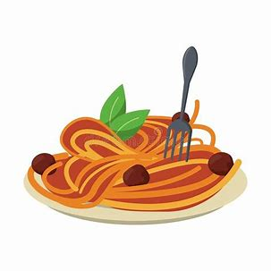
Make time for treats
With your child, think about rewards for doing revision and getting through each exam.
Rewards do not need to be big or expensive. They can include simple things like making their favourite meal or watching TV.
When the exam are over, help your child celebrate by organising an end-of-exams-
treat.

Slide 25
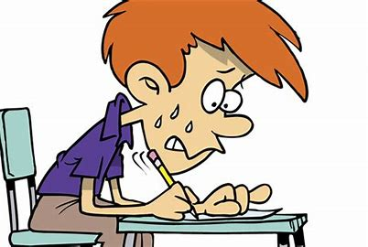
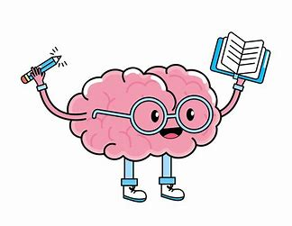
Talk about exam nerves
Remind your child that it’s normal to feel anxious. Nervousness is a natural reaction to exams. The key is to put these nerves to positive use.
If anxiety is getting in the way rather than helping, encourage your child to practice the activities they’ll be going on the day of the exam. This will help it feel less scary.
Help your child face their fears and see these activities through, rather than avoiding them.
Encourage them to think about what they know and the time they’ve already put into studying to help them feel more confident.

Slide 26

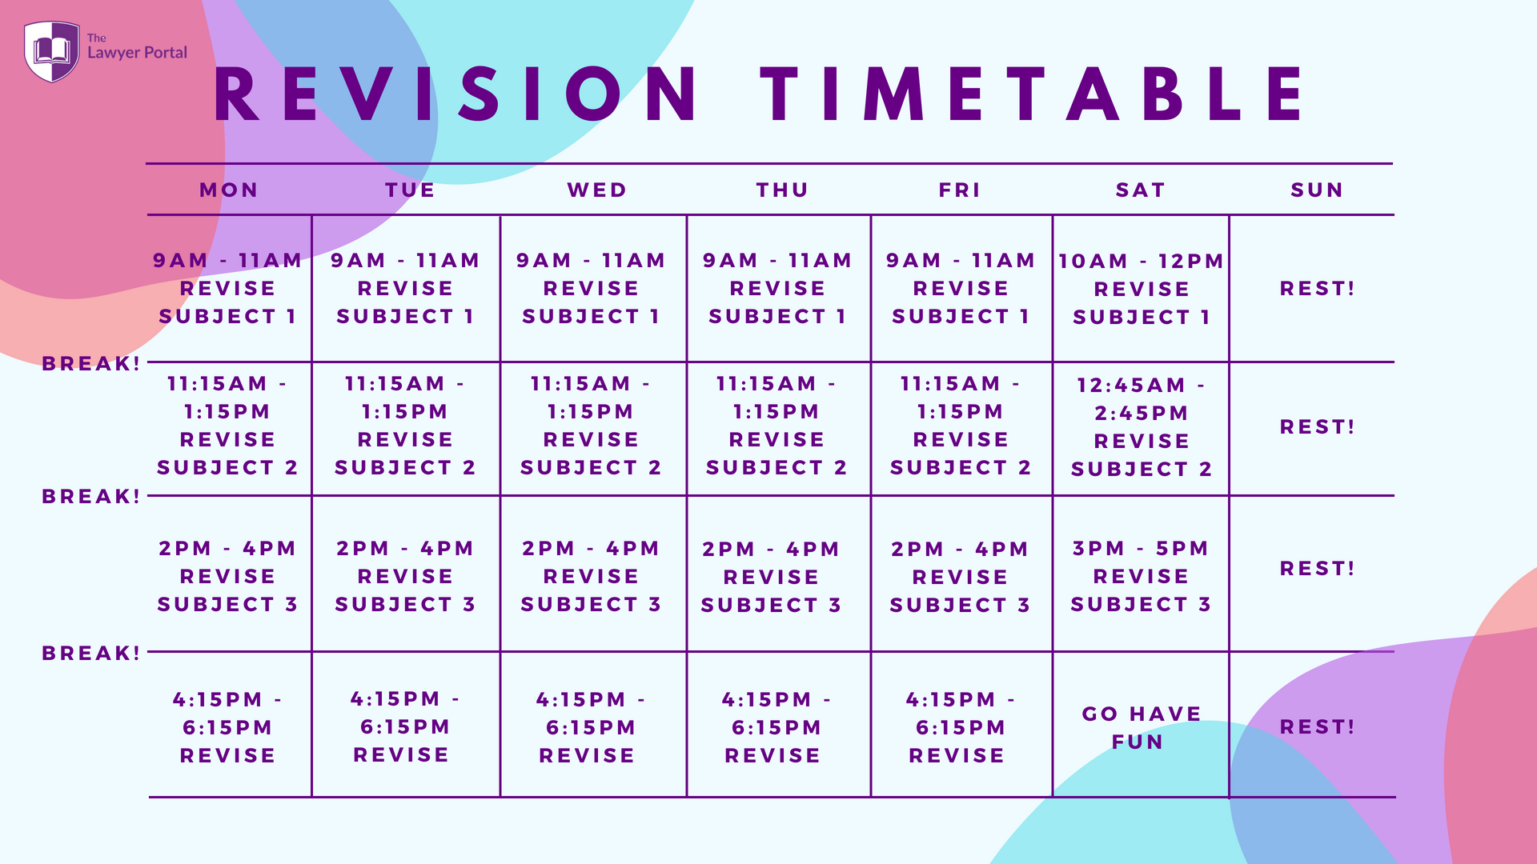
Help them study
Make sure your child has somewhere comfortable to study. Ask them how you can support them with their revision.
Help them come up with practical ideas that will help them revise.
To motivate your child, encourage them to think about their goals in life and see how their revision and exams are related to them.

Slide 27
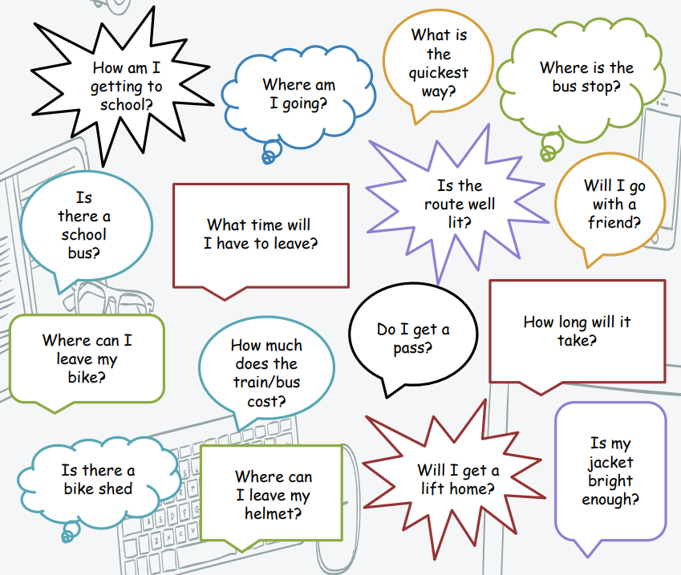
School transition – getting organised

Slide 28
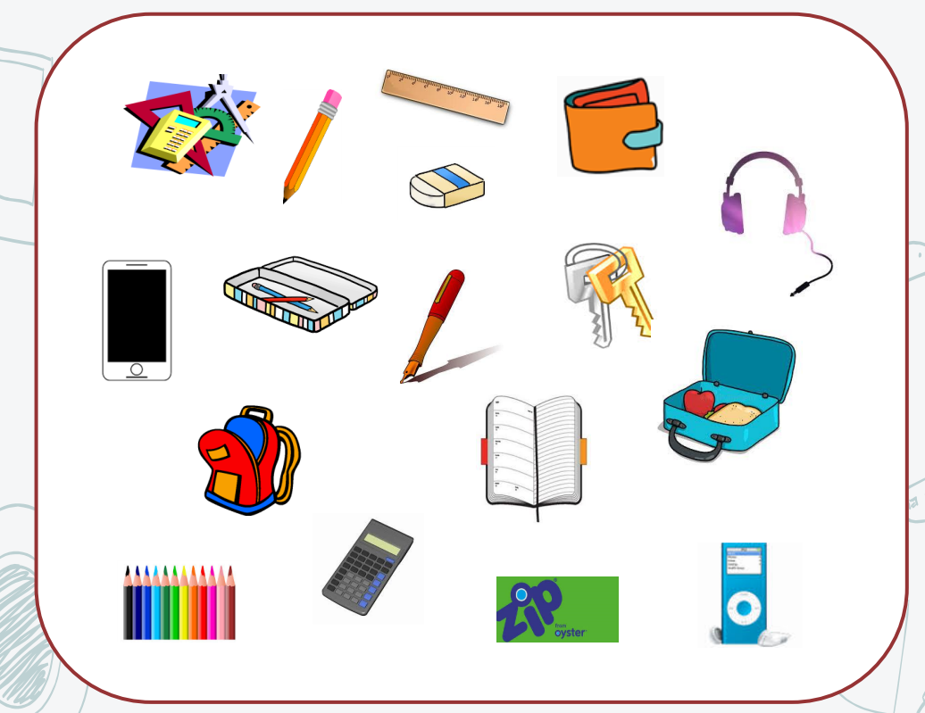
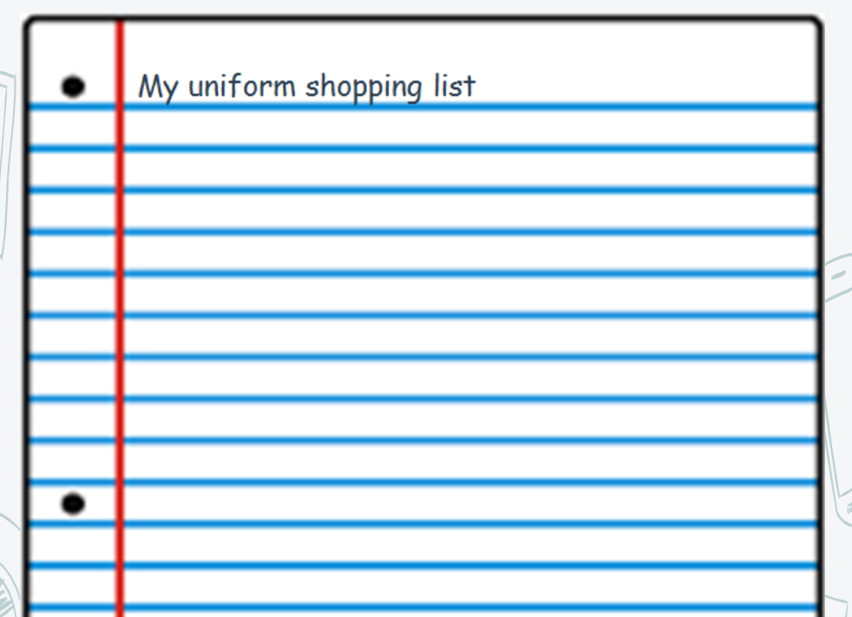
School transition – getting organised

Slide 29
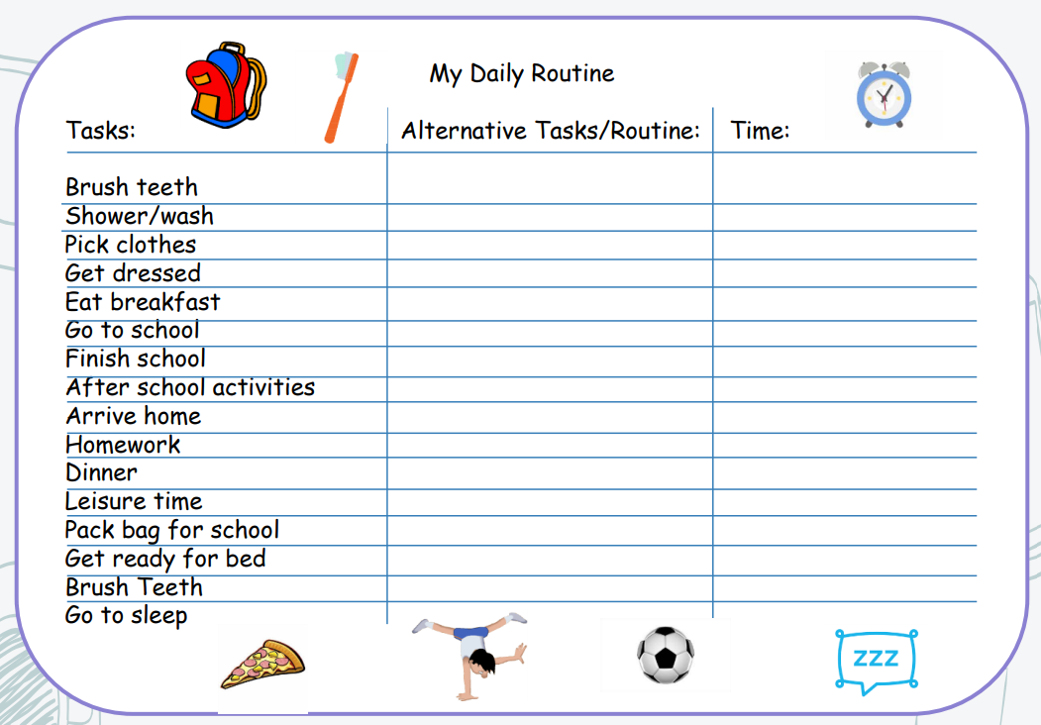
School transition – daily routine

Slide 30
School transition – problem solving
Problem | Possible solutions | Pros/cons | Is it doable? | How good is this plan? Rate 1-10 (worst-best)
Getting lost at school and being late for class | Speak to staff member Be early Check school map Avoid lesson | Help and/or guide me. Might ignore you and/ or be too busy Prepared but not practical Might not be able to read it but can help Get into trouble | Yes Yes or no Yes No | 8 6 9 0

Slide 31
summary
Today we have talked through:
What stress is and when it can be helpful.
The cycle of exam anxiety.
Techniques to help your child with exam anxiety.

Slide 32











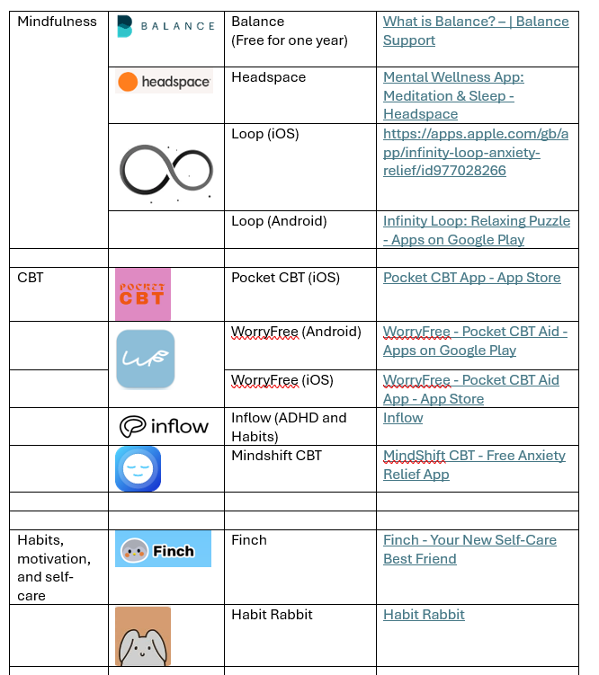
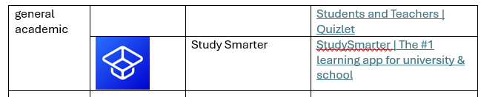
Apps

Slide 33

Any questions?

Slide 34
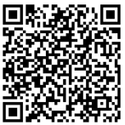
Thanks for listening!
The End!

